Slide 1
Development of a Spatial and Temporal based COVID-19 Predictor for Pakistan
Supervisor : Dr. Murk Marvi
Co-Supervisor : Ms. Anam Qureshi
18K-0137 Ovaiz Ali
18K-0166 Zaeem Ahmed
18K-0166 Rabil Maknojia

Slide 2
Literature Review (Ext.)
1) COVID-19 instances and temperature had a positive association, according to the correlation analysis. It means that a spike in COVID-19 cases was observed in Pakistan, its provinces, and administrative units, as a result of rising temperatures. Second, in Pakistan, there was no link between rainfall and COVID-19 instances. [15]
2) Finally, there was a negative association between humidity and total COVID-19 instances, implying that increasing humidity is advantageous in preventing COVID-19 transmission across Pakistan, its provinces, and administrative units. In Sindh province, humidity and COVID-19 instances were found to be positively associated. [15]
3) COVID-19 instances are influenced by a variety of factors, including geographical landscapes, economic situations, demographic illness variations, genetic factors, health care system, number of tests, and age disparities, among others. [5]
4) A huge number of undetected infected persons is also a crucial factor contributing to the spread of COVID-19. [9]

Slide 3
Literature Review (Ext.)
5) Single exponential smoothing, Holt linear trend technique, Holt winter method, and the auto-regressive integrated moving average (ARIMA) model, which was originally created for economics applications, are among the forecasting methods utilized. [6]
6) Two statistical indices, RMSE (Root Mean Square Error) and MAE (Mean Absolute Error), are used in the above mentioned models to determine the best candidate model for predicting [6]
7) Using previous data, an artificial neural network with a rectifying linear unit-based technique is used to estimate the number of deaths, recovered, and confirmed cases of COVID-19 in Pakistan. The acquired data was separated into training and test data, which were used to evaluate the suggested technique's effectiveness [8,9]
8) We turn places into nodes on a network and generate edges based on geographical proximity and demographic similarity in the Spatio-Temporal Attention Network (STAN) for pandemic prediction based on real-world evidence. Each node is linked to a set of static and dynamic features derived from a range of real-world evidence in medical claims data, such as illness prevalence and medical resource consumption conditions [10]

Slide 4

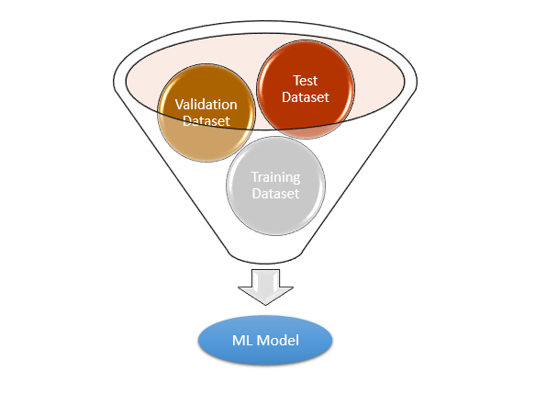
FYP-II Deliverables
Design Model for prediction | Testing

Slide 5
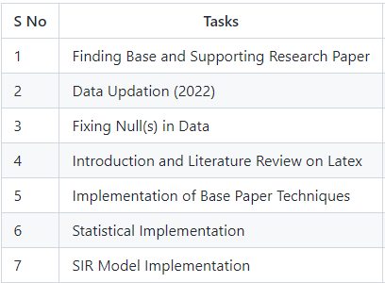
Our Timeline

Slide 6
Statistical Implementation

Slide 7
Why Statistical Analysis?

Slide 8
Insights from Statistical Analysis

Slide 9
SIR Model Implementation

Slide 10
Why use SIR Model?

Slide 11
Insights from SIR Model

Slide 12
Base Paper Implementation

Slide 13
Model Architecture

Slide 14
References
1. Bag, Rakhohori, et al. "Understanding the spatio‐temporal pattern of COVID‐19 outbreak in India using GIS and India's response in managing the pandemic." Regional Science Policy & Practice 12.6 (2020): 1063-1103.
2. Hazbavi, Zeinab, et al. "Spatial and temporal analysis of the COVID-19 incidence pattern in Iran." Environmental Science and Pollution Research 28.11 (2021): 13605-13615.
3. Huang, Rui, Miao Liu, and Yongmei Ding. "Spatial-temporal distribution of COVID-19 in China and its prediction: A data-driven modeling analysis." The Journal of Infection in Developing Countries 14.03 (2020): 246-253.
4. Sartorius, B., A. B. Lawson, and R. L. Pullan. "Modelling and predicting the spatio-temporal spread of COVID-19, associated deaths and impact of key risk factors in England." Scientific reports 11.1 (2021): 1-11.
5. Mehmood, Khalid, et al. "Spatiotemporal variability of COVID-19 pandemic in relation to air pollution, climate and socioeconomic factors in Pakistan." Chemosphere 271 (2021): 129584.
6. Ali, Muhammad, et al. "Forecasting COVID-19 in Pakistan." Plos one 15.11 (2020): e0242762.

Slide 15
References
7. Waqas, Muhammad, et al. "Analysis and prediction of COVID-19 pandemic in Pakistan using time-dependent SIR model." arXiv preprint arXiv:2005.02353 (2020).
8. Ahmad, Iftikhar, and Syed Muhammad Asad. "Predictions of coronavirus COVID-19 distinct cases in Pakistan through an artificial neural network." Epidemiology & Infection 148 (2020).
9. Shwartz-Ziv, Ravid, Itamar Ben Ari, and Amitai Armon. "Spatial-Temporal Convolutional Network for Spread Prediction of COVID-19." arXiv preprint arXiv:2101.05304 (2020).
10. Gao, Junyi, et al. "STAN: spatio-temporal attention network for pandemic prediction using real-world evidence." Journal of the American Medical Informatics Association 28.4 (2021): 733-743.
11. Nikparvar, Behnam, et al. "Spatio-temporal prediction of the COVID-19 pandemic in US counties: modeling with a deep LSTM neural network." Scientific reports 11.1 (2021): 1-12.
12. Vahedi, Behzad, Morteza Karimzadeh, and Hamidreza Zoraghein. "Spatiotemporal prediction of COVID-19 cases using inter-and intra-county proxies of human interactions." Nature communications 12.1 (2021): 1-15.

Slide 16
References
13. Sarwar, Suleman, et al. "COVID-19 challenges to Pakistan: Is GIS analysis useful to draw solutions?." Science of the Total Environment 730 (2020): 139089.
14. Saeed, Urooj, et al. "Identification of potential lockdown areas during COVID-19 transmission in Punjab, Pakistan." Public health 190 (2021): 42-51.
15. Raza, Ali, et al. "Association between meteorological indicators and COVID-19 pandemic in Pakistan." Environmental Science and Pollution Research 28.30 (2021): 40378-40393.
16. Khakharia, Aman, et al. "Outbreak prediction of COVID-19 for dense and populated countries using machine learning." Annals of Data Science 8.1 (2021): 1-19

